Slide 1
CSE- 271 Software Engineering
Lecture -5

Slide 2
Topics covered
Computer-aided software engineering
The Rational Unified Process

Slide 3
Computer-aided software engineering
Computer-aided software engineering (CASE) tools assist software engineering managers and practitioners in every activity associated with the software process. They automate project management activities, manage all work products produced throughout the process, and assist engineers in their analysis, design, coding and testing work.

Slide 4
Computer-aided software engineering
Activity automation
  Graphical editors for developing graphical system models as a part of requirement specification or software design
  Data dictionary for understanding design since it holds information about the entities and relations in a design
  Graphical UI builder for user interface construction
  Debuggers to support program fault finding
  Automated translators to generate new versions of a program.

Slide 5
Case technology
Case technology has led to significant improvements in the software process. However, these are not the order of magnitude improvements that were once predicted
  Software engineering requires creative thought - this is not readily automated;
  Software engineering is a team activity and, for large projects, much time is spent in team interactions. CASE technology does not really support these.

Slide 6
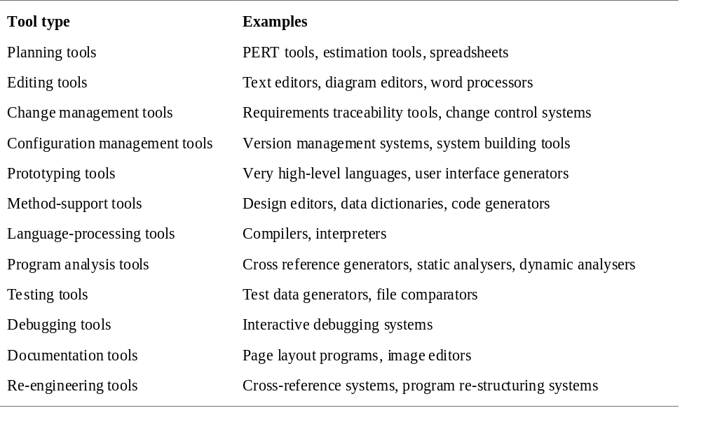
Functional tool classification
Notes:
Configuration management (CM) is a field of management that focuses on establishing and maintaining consistency of a system's or product's performance and its functional and physical attributes with its requirements, design, and operational information throughout its life.
Static code analysis is the analysis of computer software that is performed without actually executing programs built from that software (analysis performed on executing programs is known as dynamic analysis). In most cases the analysis is performed on some version of the source code and in the other cases some form of the object code. The term is usually applied to the analysis performed by an automated tool.
Configuration management (CM) is a field of management that focuses on establishing and maintaining consistency of a system's or product's performance and its functional and physical attributes with its requirements, design, and operational information throughout its life.
Static code analysis is the analysis of computer software that is performed without actually executing programs built from that software (analysis performed on executing programs is known as dynamic analysis). In most cases the analysis is performed on some version of the source code and in the other cases some form of the object code. The term is usually applied to the analysis performed by an automated tool.

Slide 7
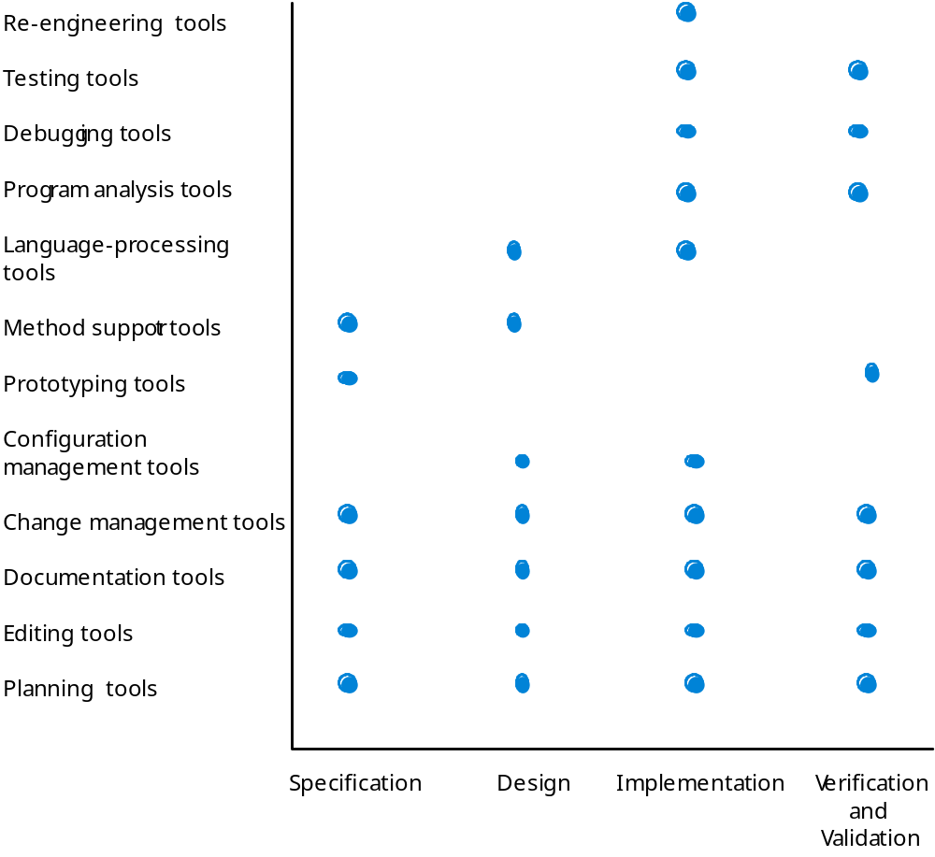
Activity-based tool classification

Slide 8
CASE integration
Tools
  Support individual process tasks such as design consistency checking, text editing, compiling a program etc.
Workbenches
  Support a process phase such as specification or design, Normally include a number of integrated tools.
Environments
  Support all or a substantial part of an entire software process. Normally include several integrated workbenches.

Slide 9
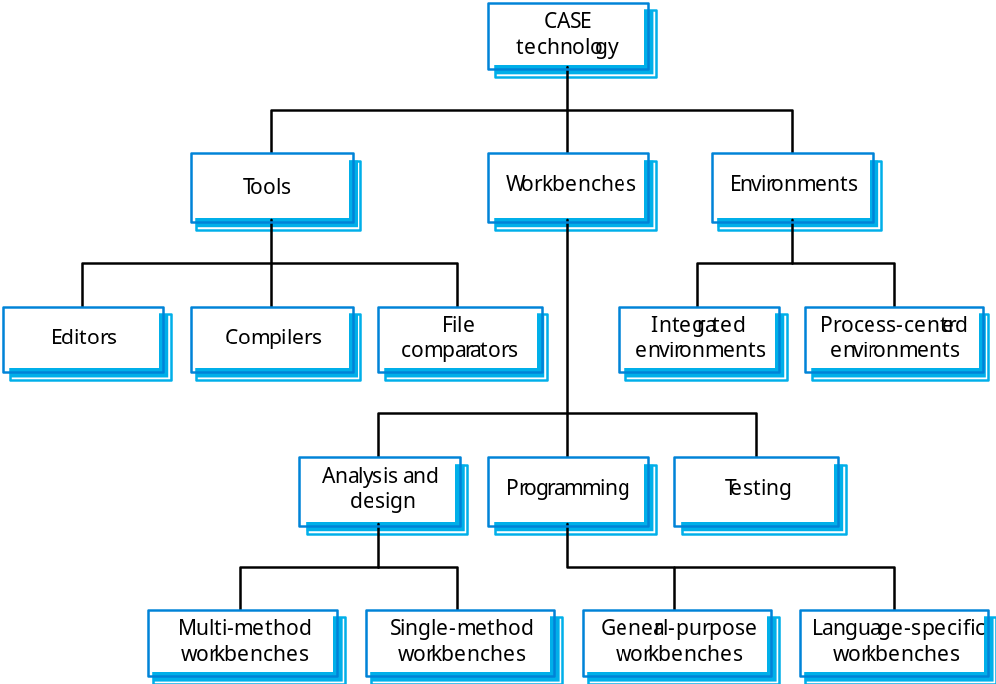
Tools, workbenches, environments

Slide 10
Unified Process (UP)
The Unified Software Development Process or Unified Process is a popular iterative and incremental software development process framework.
Characteristics of Unified Process:
  Iterative and incremental
  Use case driven
  Architecture-centric
  Risk-focussed

Slide 11
UP (Iterative & Incremental)
The Unified Process is an iterative and incremental development process.
A series of timeboxed iterations.
Each iteration results in an increment, which is a release of the system that contains added or improved functionality compared with the previous release.
Although most iterations will include work in most of the process disciplines (e.g. Requirements, Design, Implementation, Testing), the relative effort and emphasis will change over the course of the project.

Slide 12
UP (Use case –driven)
The phrase use case driven refers to the fact that the project team uses the use cases to drive all development work, from initial gathering and negotiation of requirements through code.
In the Unified Process, use cases are used to capture the functional requirements and to define the contents of the iterations.
Each iteration takes a set of use cases or scenarios from requirements all the way through implementation, test and deployment.
Why use-cases?

Slide 13
UP (Architecture-centric)
The Unified Process insists that architecture sits at the heart of the project team's efforts to shape the system and also that architecture, in conjunction with the use cases, must drive the exploration of all aspects of the system.
Since no single model is sufficient to cover all aspects of a system, the UP supports multiple architectural models and views.
One of the most important deliverables of the process is the executable architecture baseline which is created during the Elaboration phase.

Slide 14
UP (Risk-focussed)
The Unified Process requires the project team to focus on addressing the most critical risks early in the project life cycle.
The deliverables of each iteration, especially in the Elaboration phase, must be selected in order to ensure that the greatest risks are addressed first.

Slide 15
UP Phases
Inception:
  Business rationale, contribution to business, scope, identify risks, estimates
Elaboration:
  Requirements, high-level analysis and design of baseline architecture, construction plan, risk management.
Construction:
  Implement system features
    iteration 1: use cases A,B,C implemented
    iteration 2: use cases D,E implemented
    ...
Transition:
  Deployment, Beta testing, performance tuning, user training.

Slide 16
RUP Phases – General Overview
Inception
  Establish the business case for the system. Assess the contribution the system makes to the business. If this contribution is minor then the project may be cancelled after this phase. It is to decide if the project is worth a serious investigation (during elaboration), not to do that investigation. Cost Benefit Analysis, Initial Risk Analysis.
Elaboration
  Develop an understanding of the problem domain and the system architecture. After this phase, you should have requirements model, an architectural description and a development plan for the software.

Slide 17
RUP phases
Construction
  System design, programming and testing. On completion of this phase, you should have a working software system and associated documentation.
Transition
  Moving the system from the development community to the user community. Deploy the system in its operating environment. On the completion of this phase, you will have a documented software system that is working correctly in its operational environment.

Slide 18
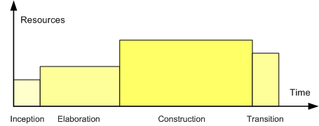
Relative size of the phases

Slide 19
Refinements & Variations
Refinements of the UP vary from each other in how they categorize the project disciplines or workflows, how different project artifacts are emphasized, how the phases after Transition are specified.
Organizations utilizing the UP invariably incorporate their own modifications and extensions.
  Agile Unified Process (AUP) created by Scott Ambler.
  Basic Unified Process (BUP)
  Enterprise Unified Process (EUP)
  Essential Unified Process (EssUP)
  Open Unified Process (OpenUP)
  Rational Unified Process (RUP) created by Rational Software Co.
  Oracle Unified Method (OUM)

Slide 20
RUP (Rational Unified Process)
The best-known and extensively documented refinement of the Unified Process is the Rational Unified Process or RUP.
IBM Rational Unified Process (RUP) is a comprehensive process framework that provides proven best practices for software and systems delivery and implementation and effective project management.

Slide 21
RUP
It provides a disciplined approach to assigning tasks and responsibilities within a development organization.
Its goal is to ensure the production of high-quality software that meets the needs of its end-users, within a predictable schedule and budget.
RUP enhances team productivity, by providing every team member with easy access to a knowledge base with guidelines, templates and tool mentors for all critical development activities.
By having all team members accessing the same knowledge base, no matter if you work with requirements, design, test, project management, or configuration management, we ensure that all team members share a common language, process and view of how to develop software.

Slide 22
Knowledge Base
The knowledge base contains a lot of hypertext links, and overviews of the various process elements are presented through interactive images, making it easy to find relevant information in an intuitive fashion.

Slide 23
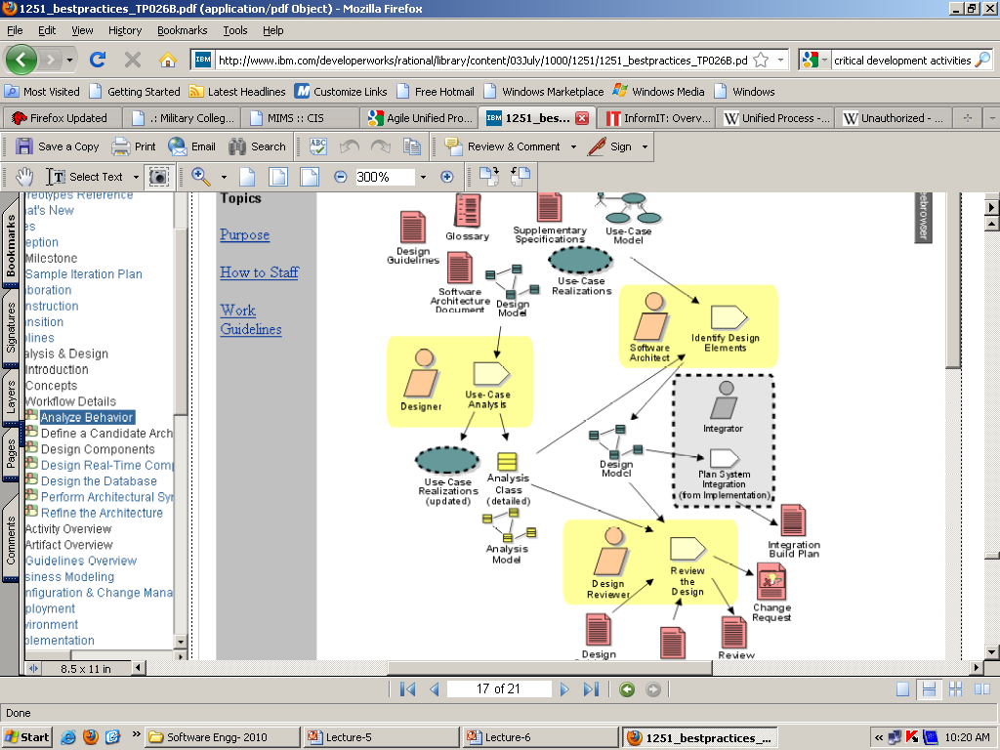

Slide 24
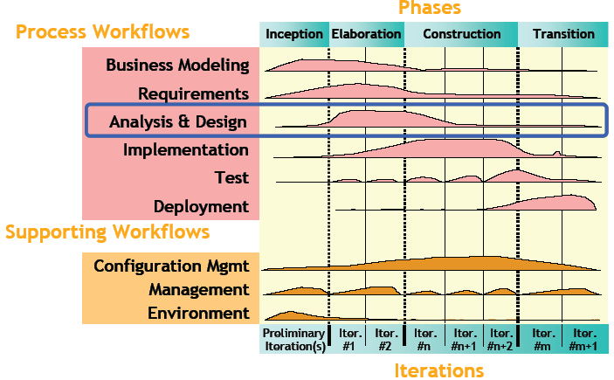

Slide 25
Workflows / Disciplines
Business modelling
  Domain object modeling,
Requirements
  Writing use cases, identifying non functional requirements
Analysis & Design
  overall architecture, objects, databases, networking
Implementation
  Programming the system
Test
  Verification of system interactions
Deployment
  Product releases, installation, delivery
Configuration Management
  managing multiple variants of evolving software systems, tracking which versions are used in given software builds, enforcing policies.
Environment
  Establishing the tools and customizing the process for the project, setting up the tool and process environment

Slide 26
Features
The RUP activities create and maintain models.
Rather than focusing on the production of large amount of paper documents, the Unified Process emphasizes the development and maintenance of models—semantically rich representations of the software system under development.
The Rational Unified Process is supported by tools, which automate large parts of the process.
They are used to create and maintain the various artifacts—models in particular—of the software engineering process: visual modeling, programming, testing, etc.

Slide 27
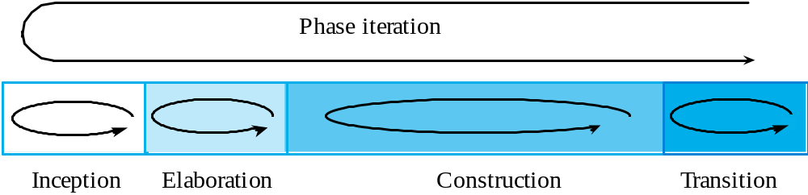
RUP phase model

Slide 28
Suggested Reading
Handout # 2
  ‘Rational Unified Process, Best Practices for Software Development Teams’
  (Uploaded on Learning Management System)

